Slide 1

UART Palindrome Checker
By: Kenneth Galindo
ECE 520
Spring 2022
Instructor: Saba Janamian

Slide 2
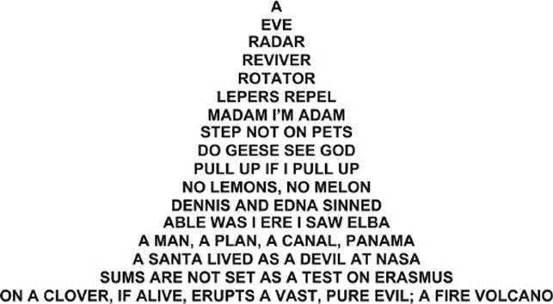
What is a Palindrome?
A palindrome is a single word, letter, or phrase/combination of strings that can be read the same from either direction.
Eg: Dad, mom, racecar, A nut for a jar of Tuna
For this implantation, only words will be utilized
[1]

Slide 3
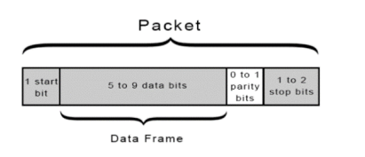
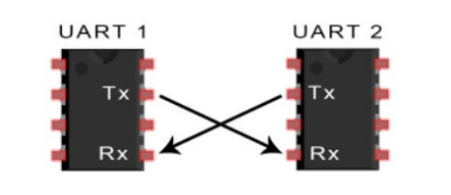
UART Universal Asynchronous Receiver/Transmitter
Referred to as Universal since the data format and speed of transmission can be reconfigured, and Asynchronous since it does not have a clock.
Instead of using a clock, UART utilizes start and stop bits to the data packet that is being transmitted, which define the beginning and end of the data packet
It is important to know that both UARTs must be configured to transmit and receive the same data packet structure.
[2]

Slide 4
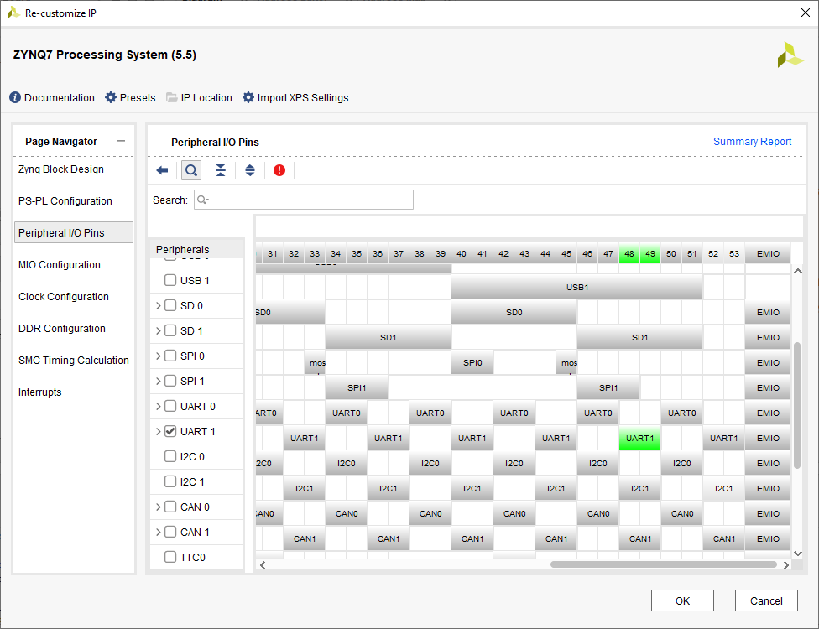
Hardware
Equipped a Zynq7 processor IP
Enabled only UART
Ran connection automation
Created wrapper and generated bitstream

Slide 5
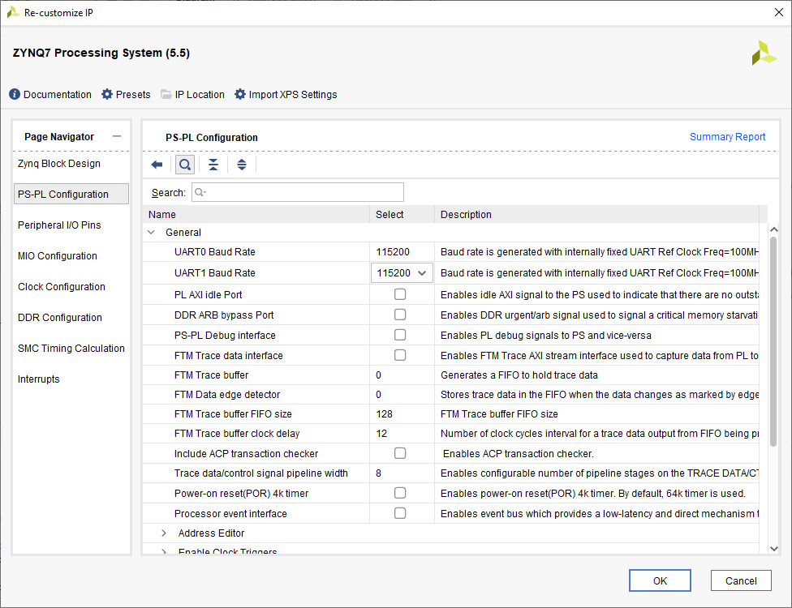
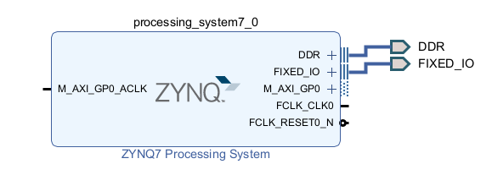
Hardware
Ensured BAUD rate was set at 115200
Final IP block to be exported

Slide 6
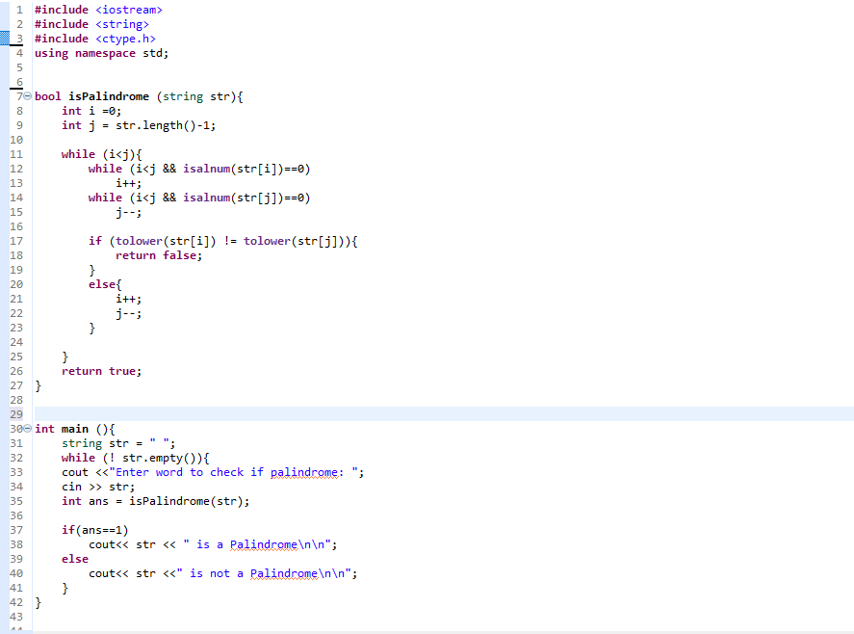
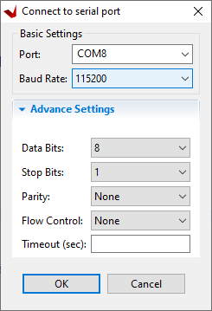
Software
Created C++ file for palindrome
Boolean method for comparisons
Main used as driver, with user input
Input taken at Vitis Serial Terminal

Slide 7
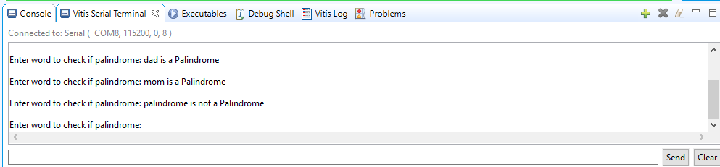
Results
Demonstrating palindrome results for each word
Should be noted no phrases were used due to implementation of C++ code

Slide 8
References
[1] https://javascript.plainenglish.io/the-best-and-worst-way-of-solving-the-palindrome-question-4b7d2f9ada06
[2] https://www.circuitbasics.com/basics-uart-communication/
[3] https://www.youtube.com/watch?v=33dmXAAaD28

